Slide 1




Anastasios Rentoumis, Alliance for Integrated Care
Dimitrios Boucharas, University of Ioannina
Smart Big Data Platform to Offer Evidence-based Personalised
Support for Healthy and Independent Living at Home

Slide 2
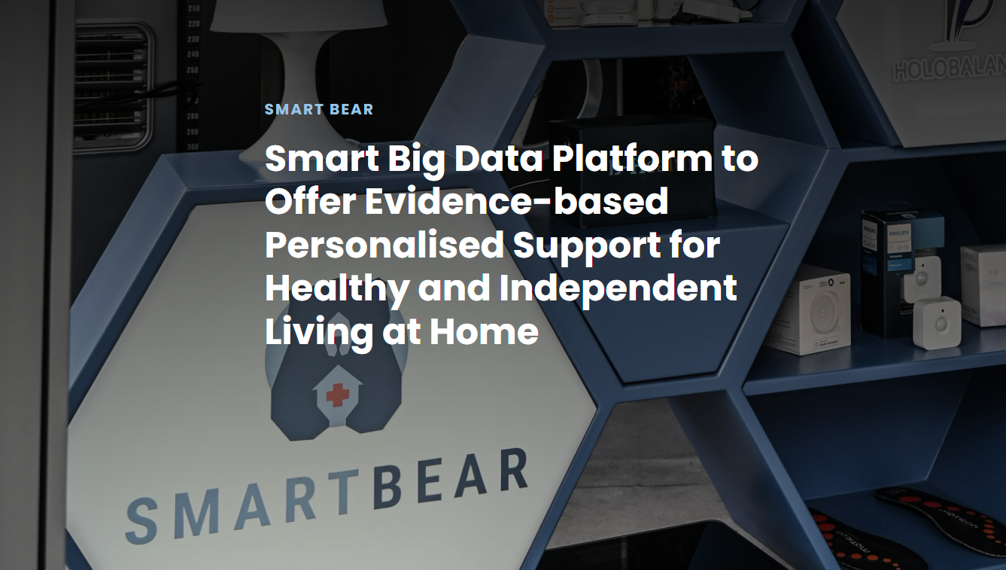
OVERALL AIM
The development of an innovative platform to support the healthy and independent living of elderly people with combinations of the following conditions: Hearing Loss, Cardio Vascular Diseases, Cognitive Impairment, Mental Health Issues, Balance Disorders, and Frailty.
The platform support interventions on:
lifestyle changes
medically-significant risk factors, and
chronic disease management
The platform is based on or integrates:
medical sensing off-the-shelf devices
big data analytic capabilities (data management and analytics)
security and privacy preserving, and security assurance
mechanisms
5 Large-Scale Pilots
France, Greece, Italy, Portugal and Romania, 4.000 participants, 5 years

Slide 3
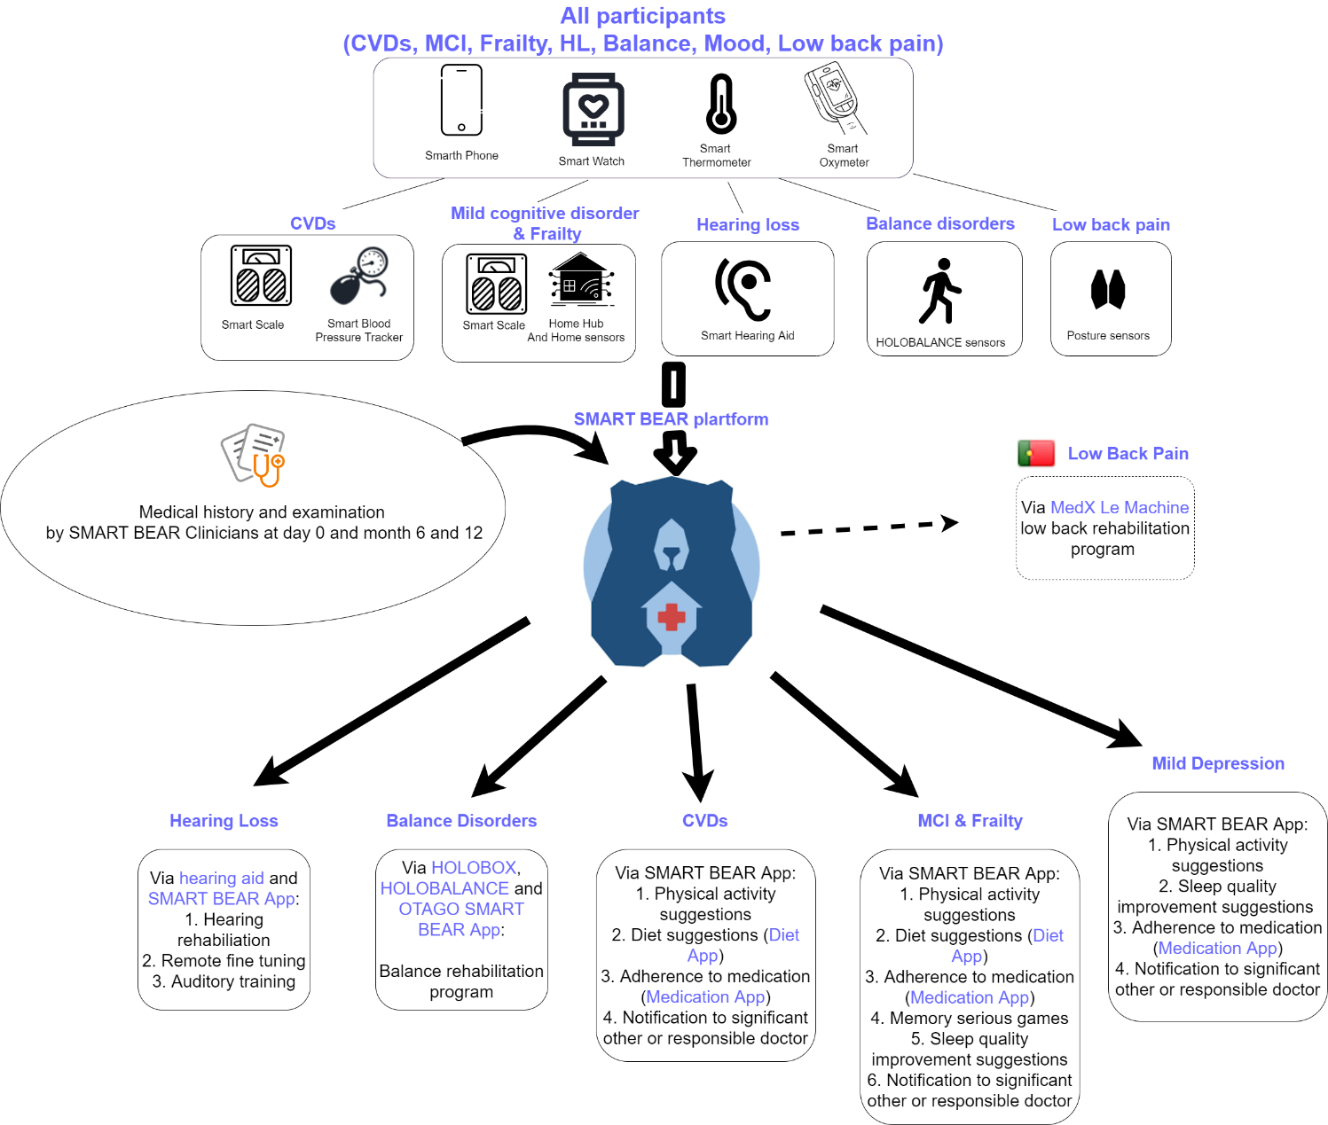


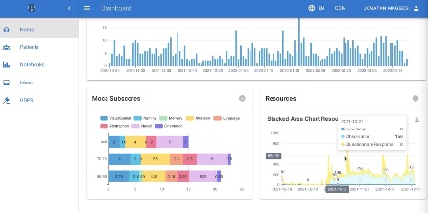
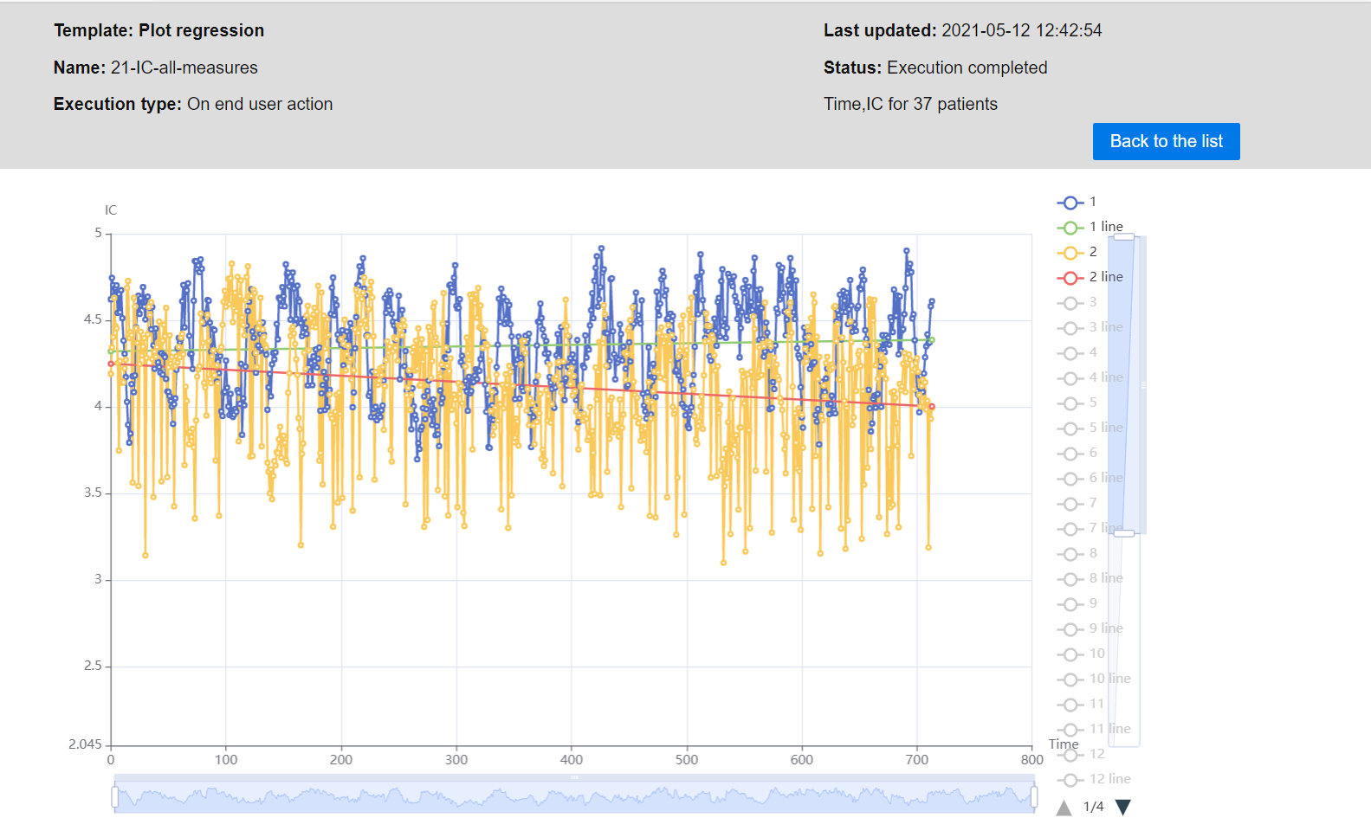
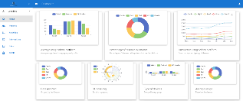
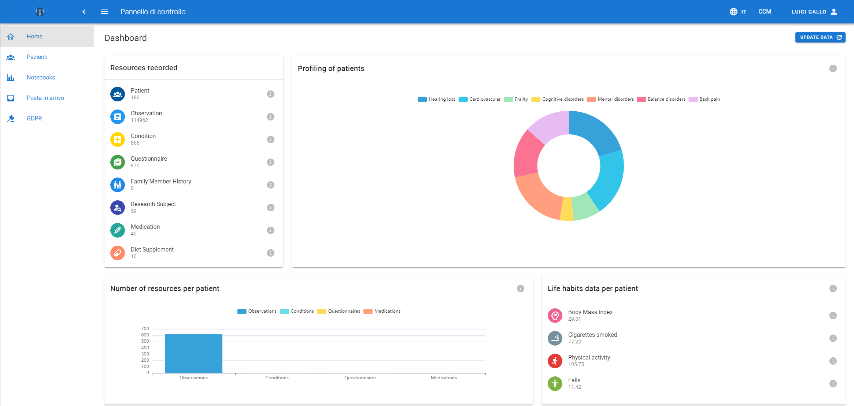



Smart Bear Devices
All participants
CVDs
MCI & Frailty
Hearing Loss
Balance
Low back pain
Madeira Regional Health System
The
SMART BEAR ecosystem
in a nutshell
SMART BEAR Platform
Low back pain
Medical history and examination
by Smart Bear Clinical Team Members
Smart4Health
Mild depression
Hearing Loss
Balance
CVDs
MCI & Frailty

Slide 4
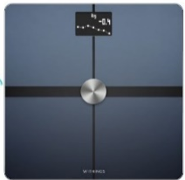
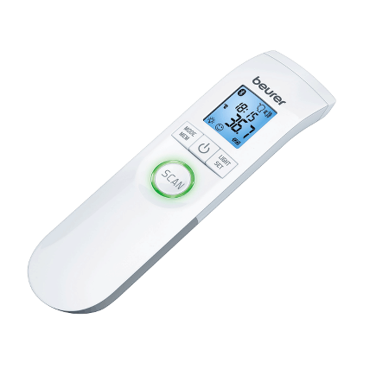
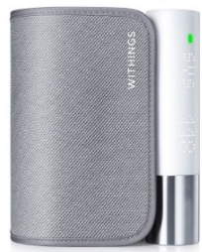
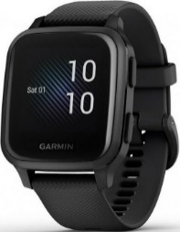
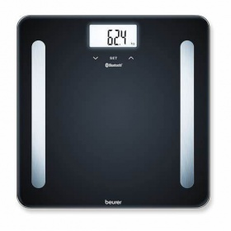
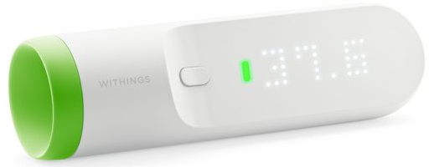
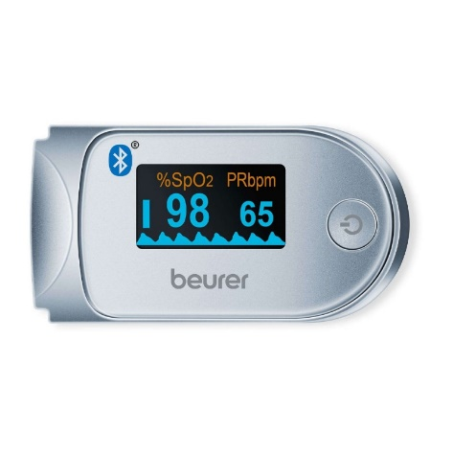
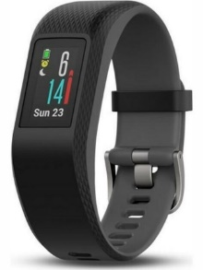
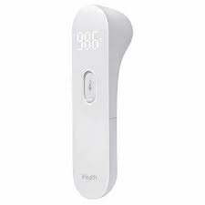
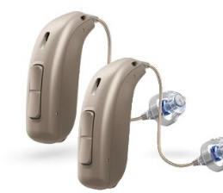
Additional Device Federation
  Withings Body+
Implemented a total of 18 distinct devices
  Beurer Thermometer
  Withings BPM Core
  Garmin Venu SQ
  Withings Smart Thermometer
  Beurer Scale
  Garmin Vivosport
  iHealth PT3
  Beurer Oximeter
  Oticon Minirite T

Slide 5

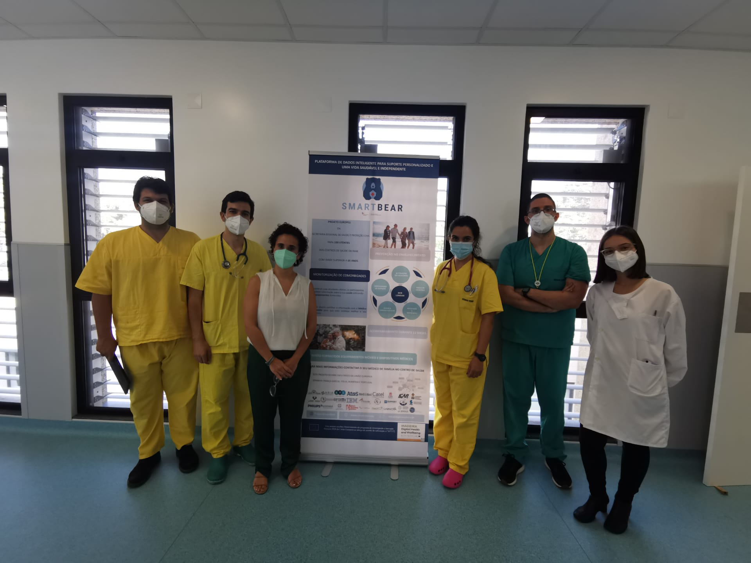


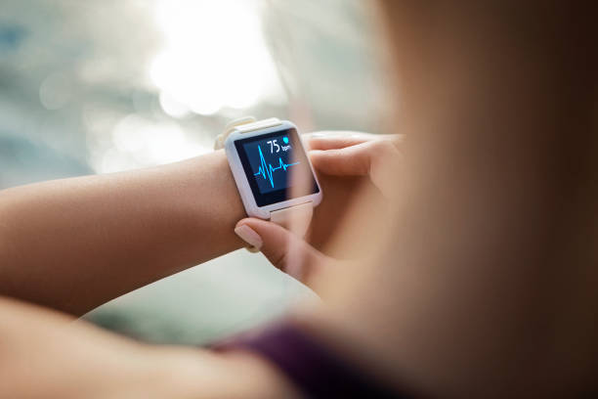
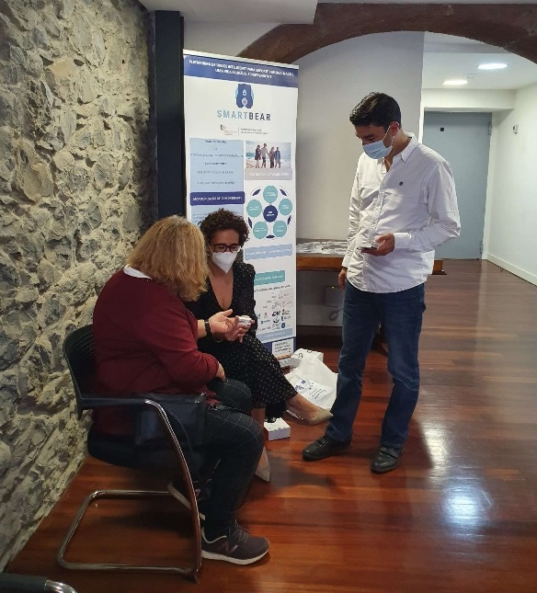
CLINICAL OBJECTIVES
Reducing morbidity
Active monitoring
of vital, behavioral
and environmental parameters
Integrated, Preventive Care
Improving quality of life
Active prevention through proactive lifestyle and
wellbeing activities
Support at home
Cost Effective Care adoptable by NHS and people
ICER above C/E plane using the MAFEIP model
Willingness to Pay study to assess service market price
5 countries
5 years
> 4000
EU citizens
1. ≥2 comorbidities
2. MoCA (score > 18)
3. Health Utility Index (HUI3, score = 1-4)
≥ 65 y.o. males and females

Slide 6
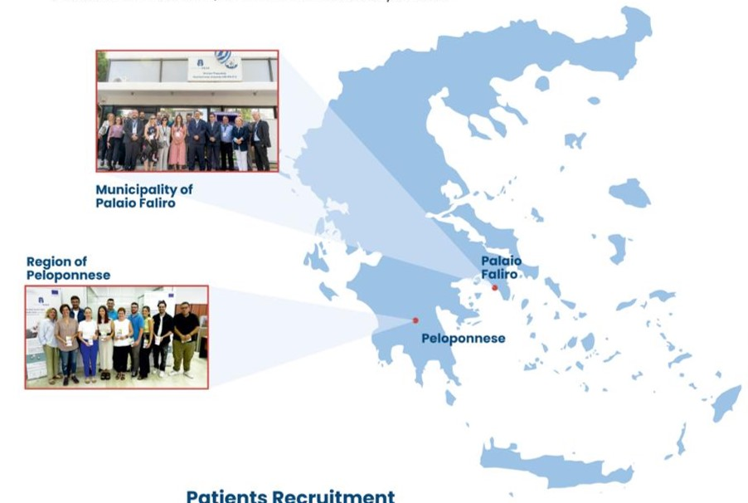
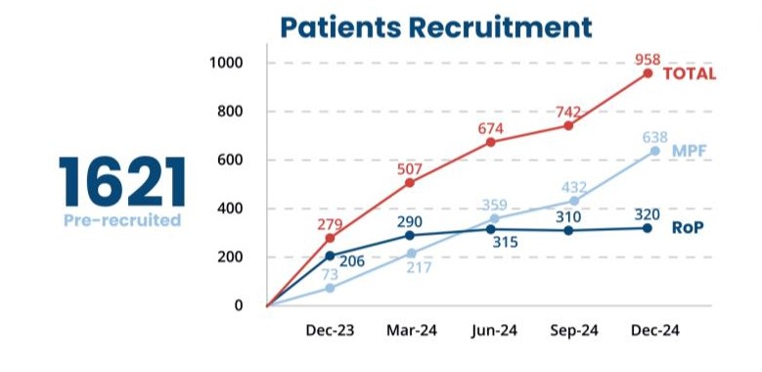
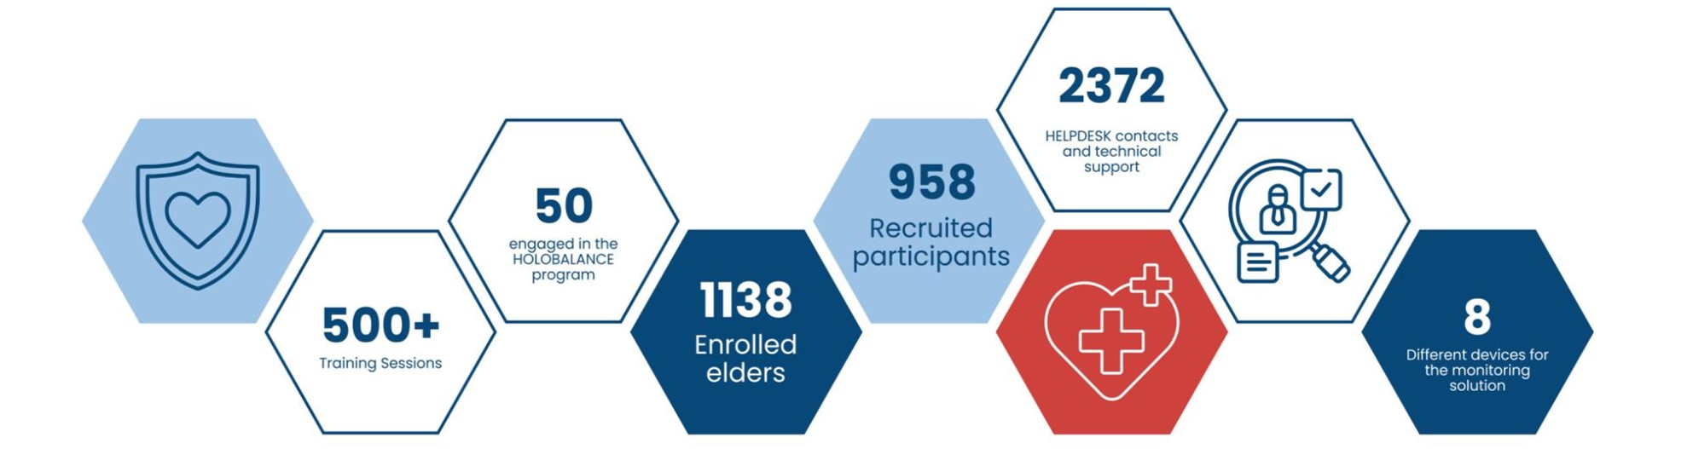
Timeline of Pilot Study and Key Facts

Slide 7
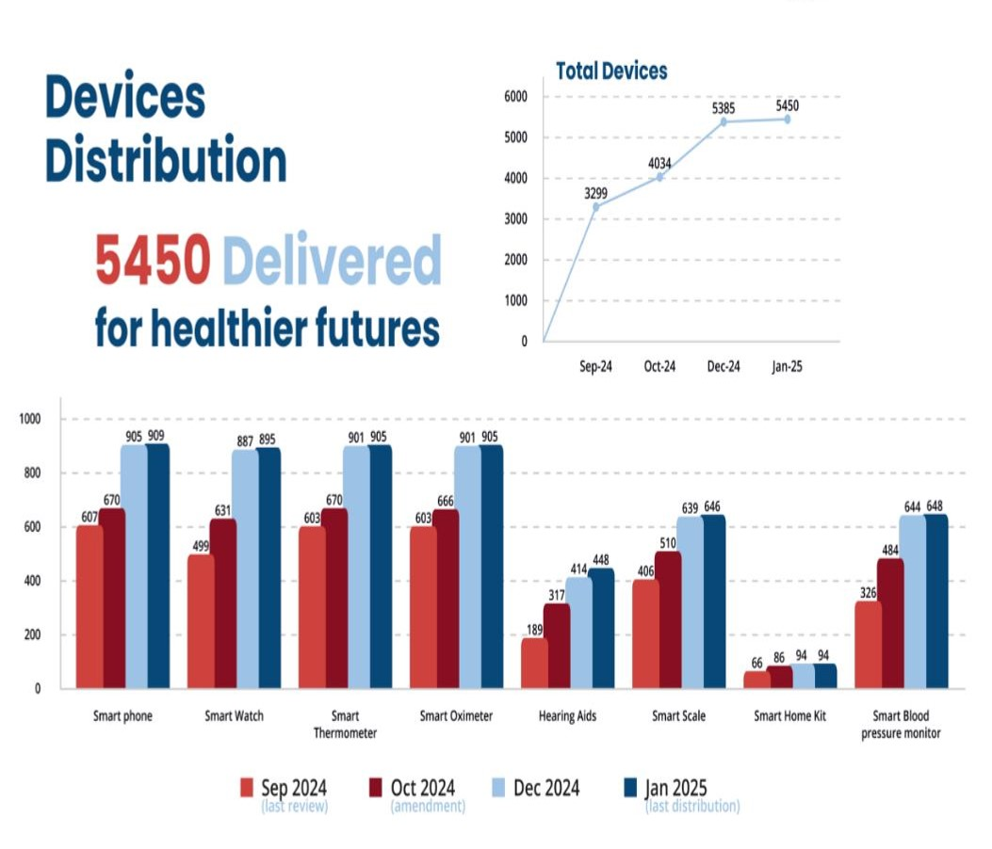
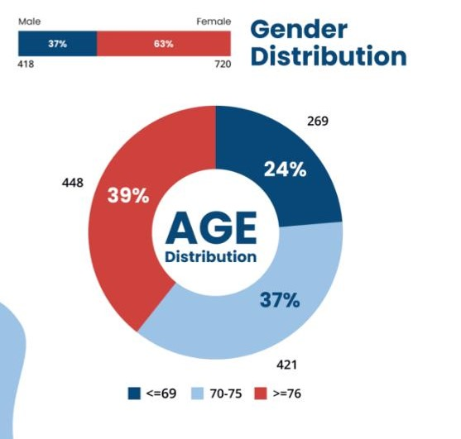
Timeline of Pilot Study and Key Facts
Smart Bear - Project Overview

Slide 8
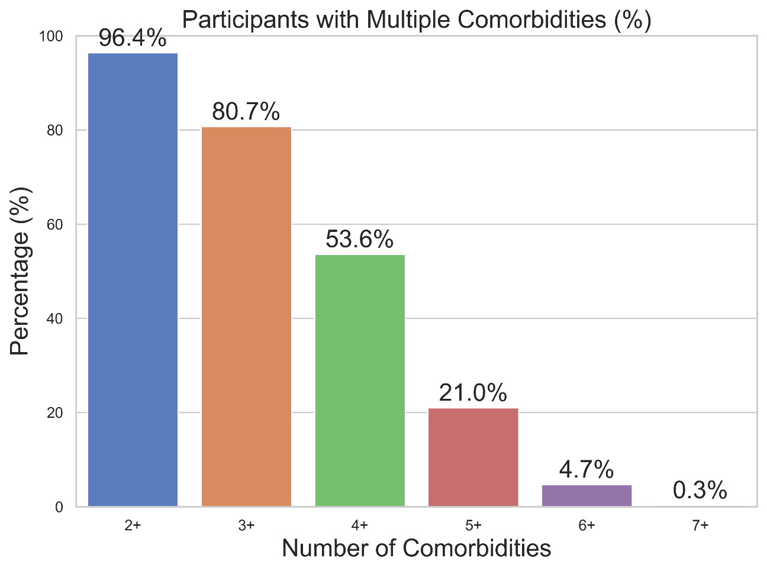
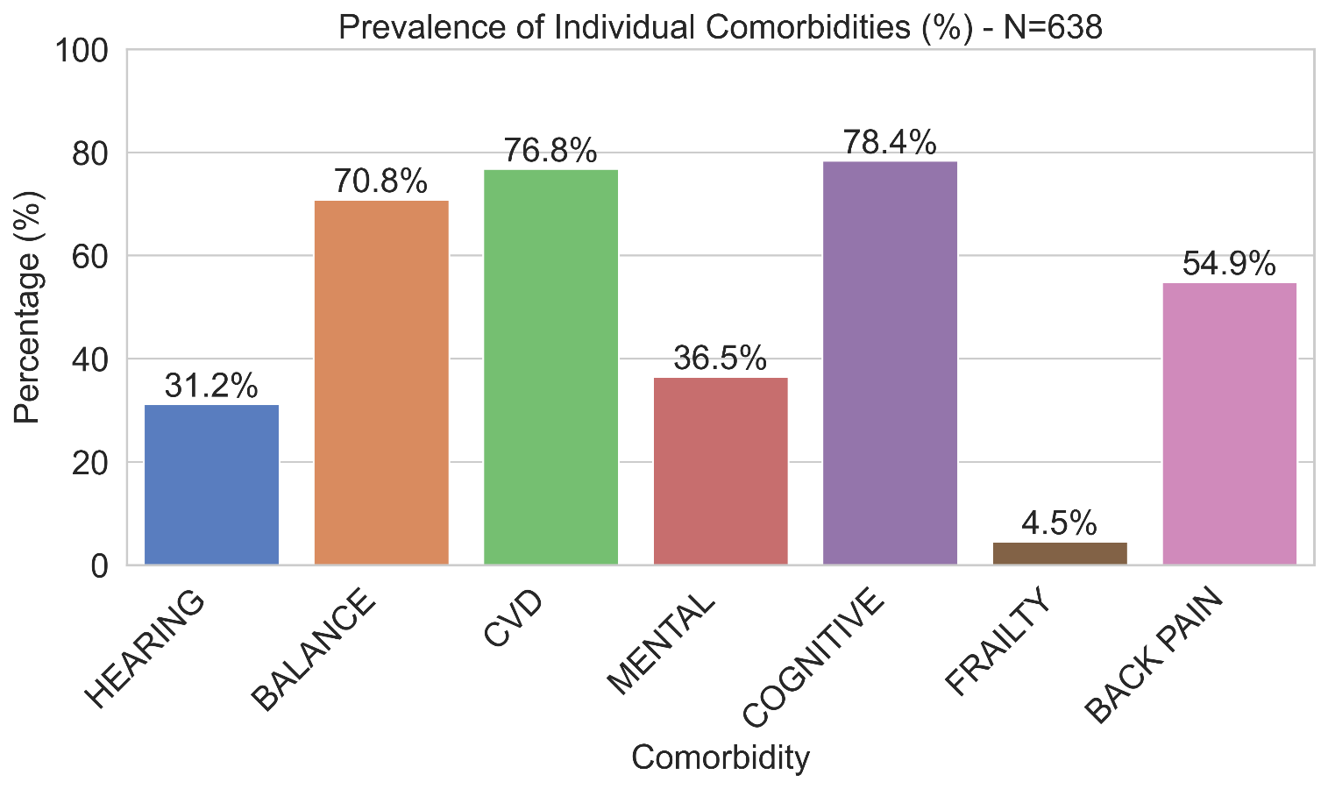
Clinical Entities Prevalence
The most prevalent comorbidities were cognitive impairment (78.4%), cardiovascular disease (76.8%), and balance disorders (70.8%), with over 96% having two or more comorbidities and more than 50% had four or more conditions
Need in the ageing population: integrated, multimorbidity-aware digital interventions.
Notes:
Done

Slide 9

Questionnaire Evaluation
COGNITIVE
MOCA
Assesses cognitive function including memory, attention, and executive function.
PHQ-9
Measures depression, which is related to emotional-cognitive well-being.
GDS
Geriatric Depression Scale: Assesses depression in older adults
SQS
Evaluates sleep, closely linked to cognitive and emotional health
Standardized Questionnaires
FUNCTIONAL (Physical / Daily Living)
POSTURAL / BALANCE (+HLB)
IADL
Assesses independence in instrumental activities of daily living (e.g., cooking, shopping).
MDPQ
Mobile Device Proficiency Questionnaire Assesses digital literacy and functional tech use
RGA
Multidomain tool for frailty, sarcopenia, nutrition, and function
GODIN
Reflects physical activity frequency (linked to balance capacity)

Slide 10
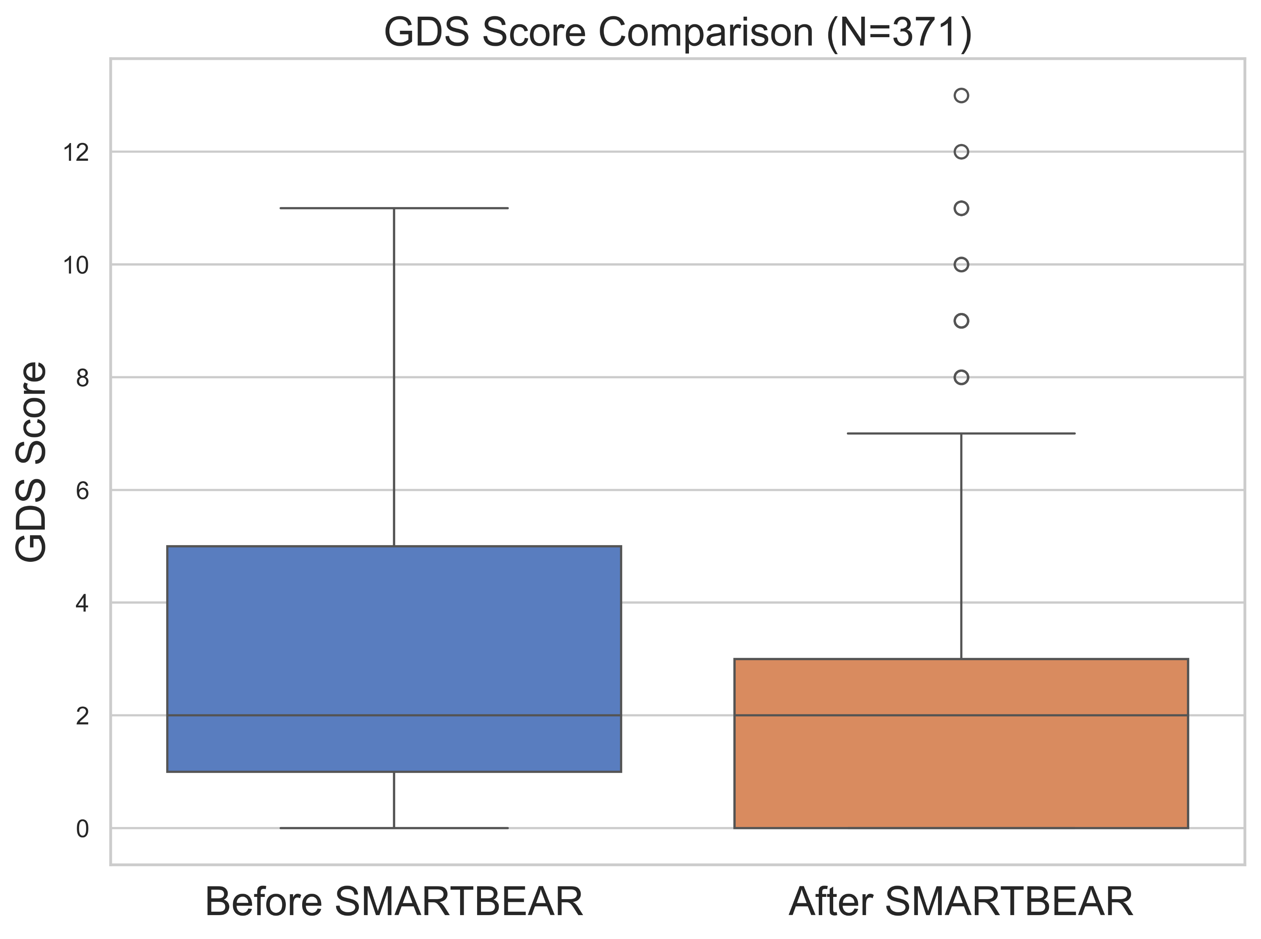
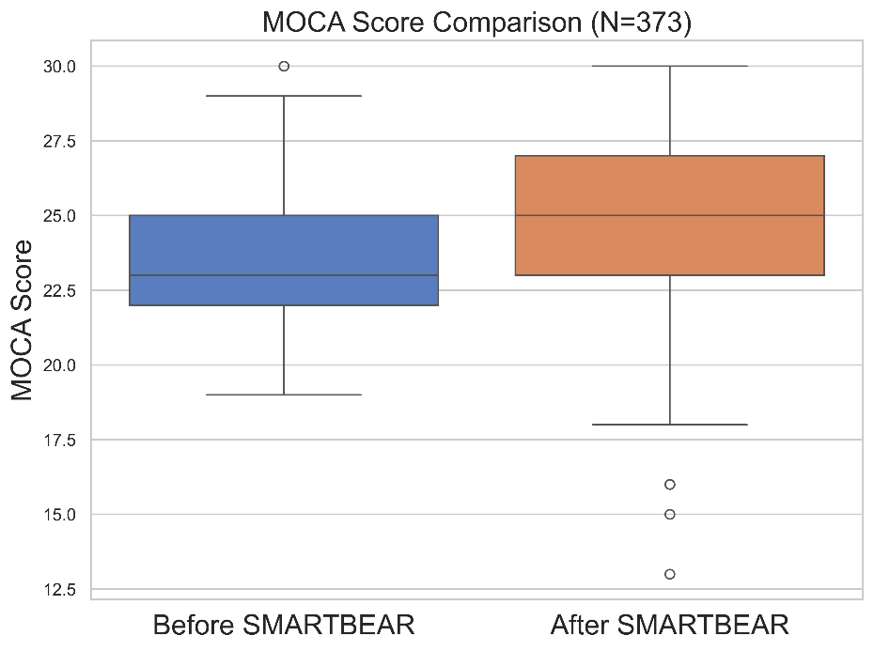


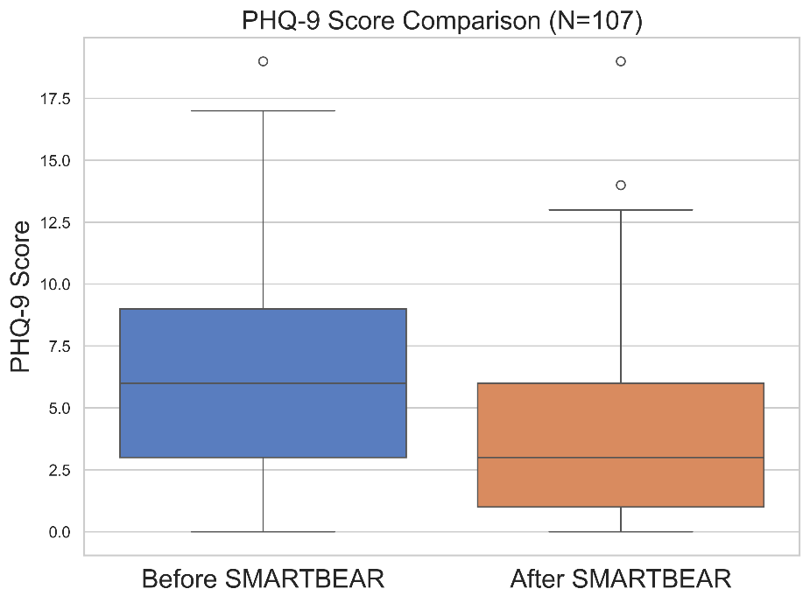
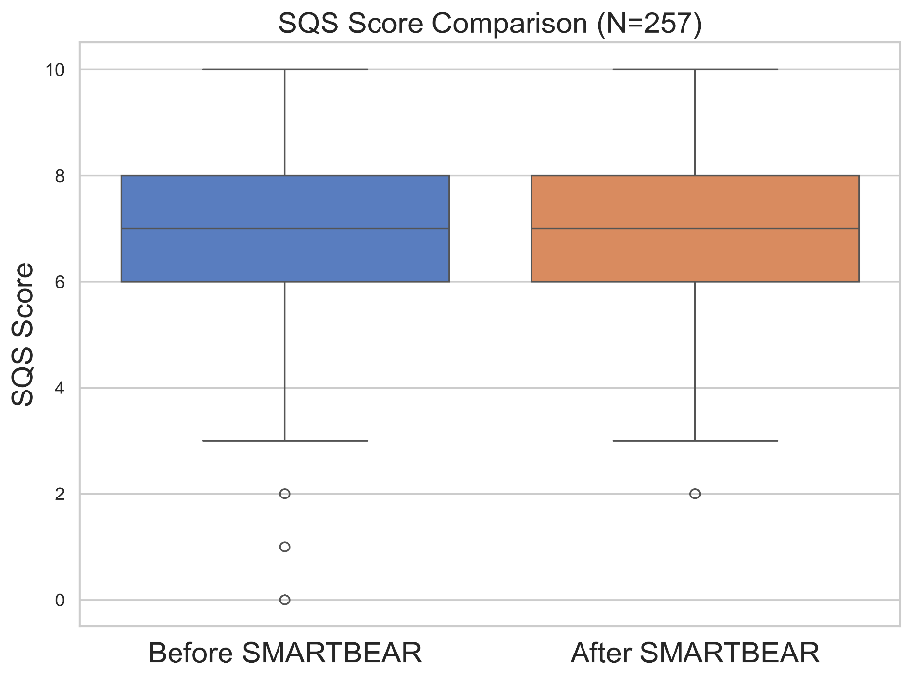


Cognitive Evaluation
Improved Cognitive Function: MOCA scores increased post-intervention, indicating an improved cognitive performance
Reduced Depression Symptoms: Both PHQ-9 and GDS scores showed a noticeable decrease, reflecting lower depression levels following the intervention.
Stable Sleep Quality: limited impact on subjective sleep quality.
Notes:
Done

Slide 11
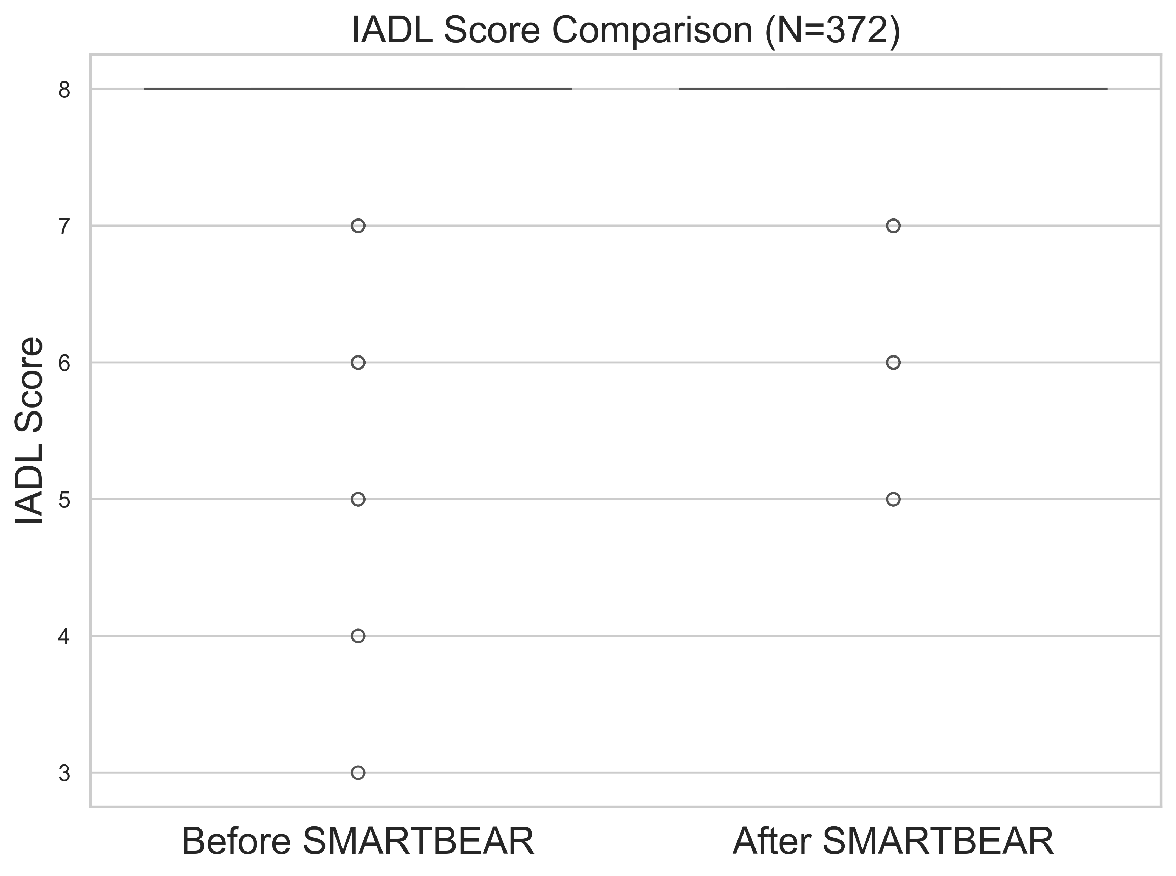
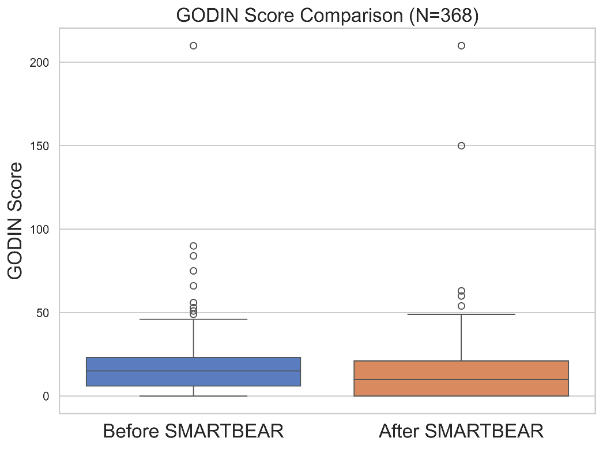
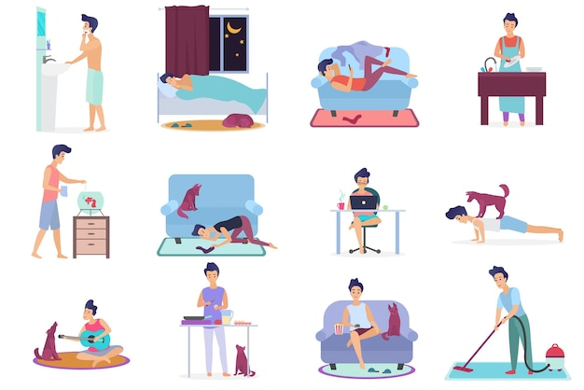
Functional Evaluation I
Stable Daily Functioning: Both IADL & GODIN scores remained consistently high before and after SMARTBEAR, suggesting participants maintained their independence in daily living tasks.

Slide 12
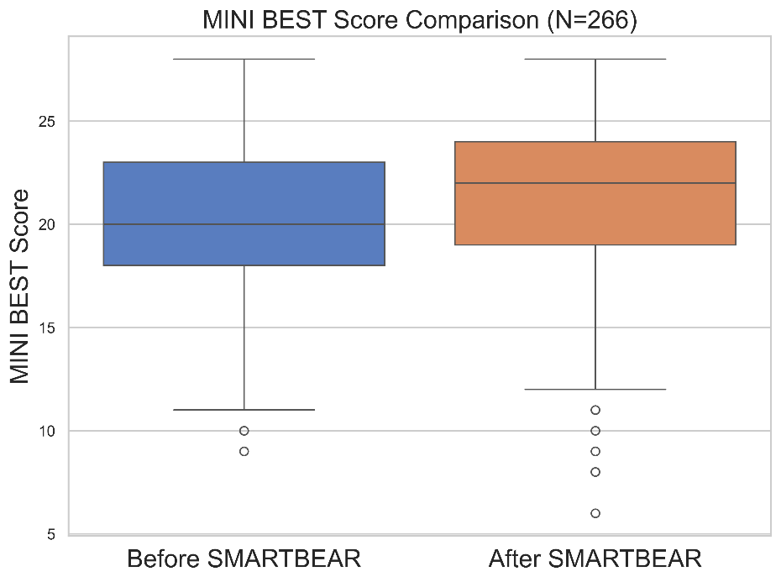

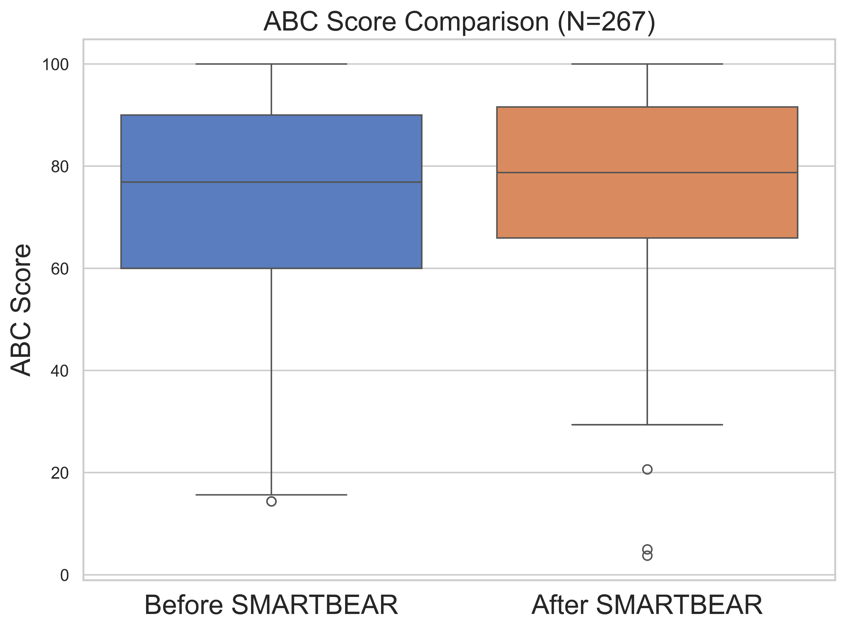
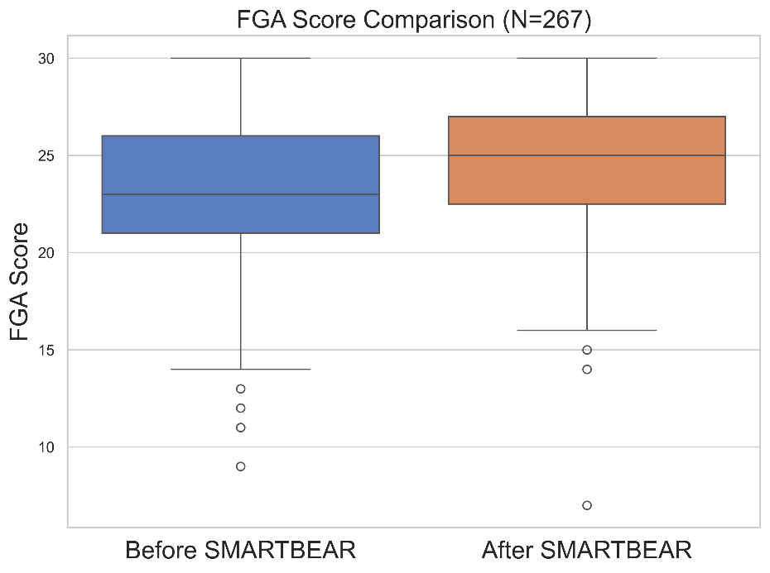
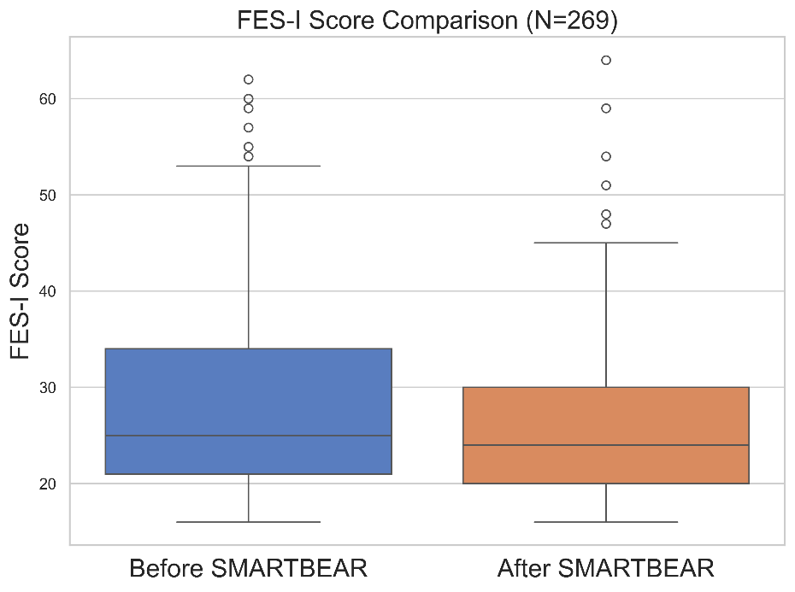


Balance & Postural Evaluation
Improved Balance Performance: Scores on MINI BEST and FGA increased after SMARTBEAR, indicating measurable gains in dynamic balance and gait stability.
Increased Balance Confidence: higher ABC scores, reflecting greater confidence in performing daily activities without losing balance.
Reduced Fear of Falling: FES-I scores decreased post-intervention, suggesting reduced fear of falling—a key psychological barrier to mobility in older adults.
Notes:
Done

Slide 13
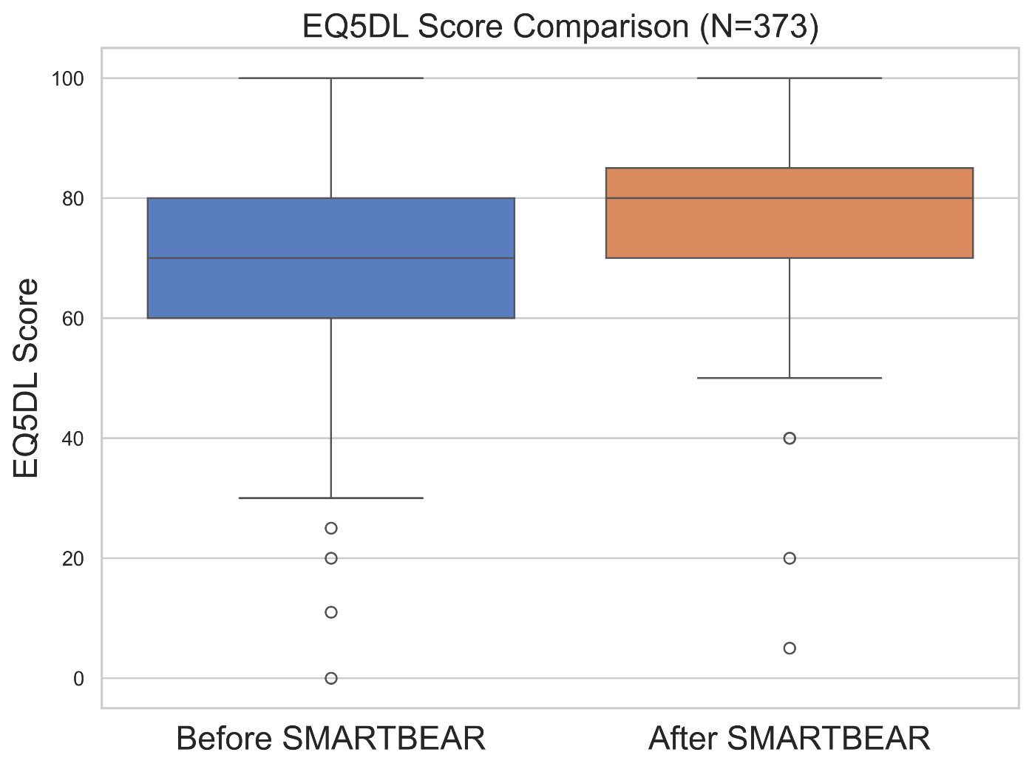

QoL Evaluation
Improved Quality of Life: EQ5DL scores increased after SMARTBEAR, indicating enhanced self-reported health and well-being among participants.
Notes:
Done

Slide 14
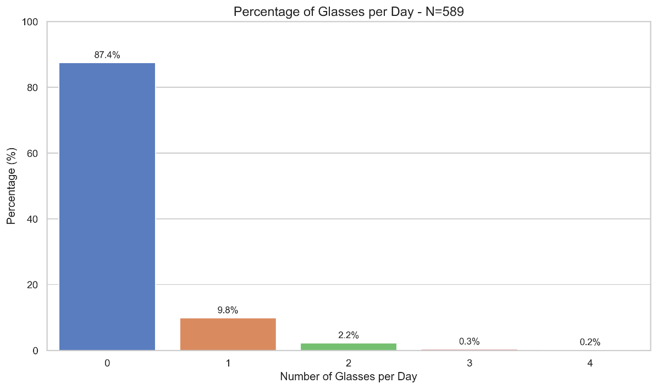
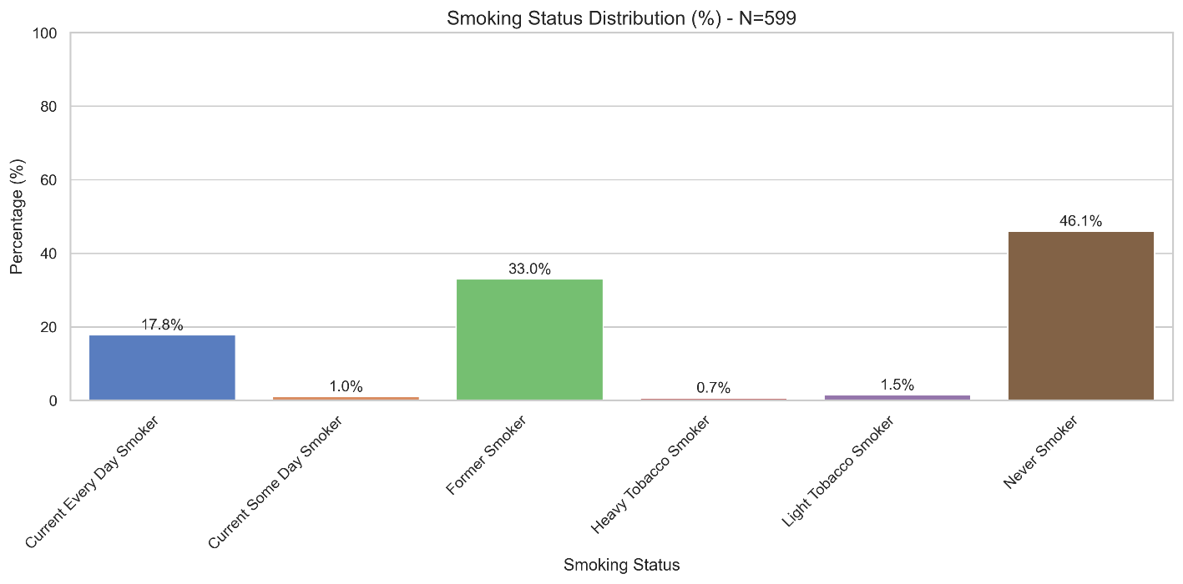
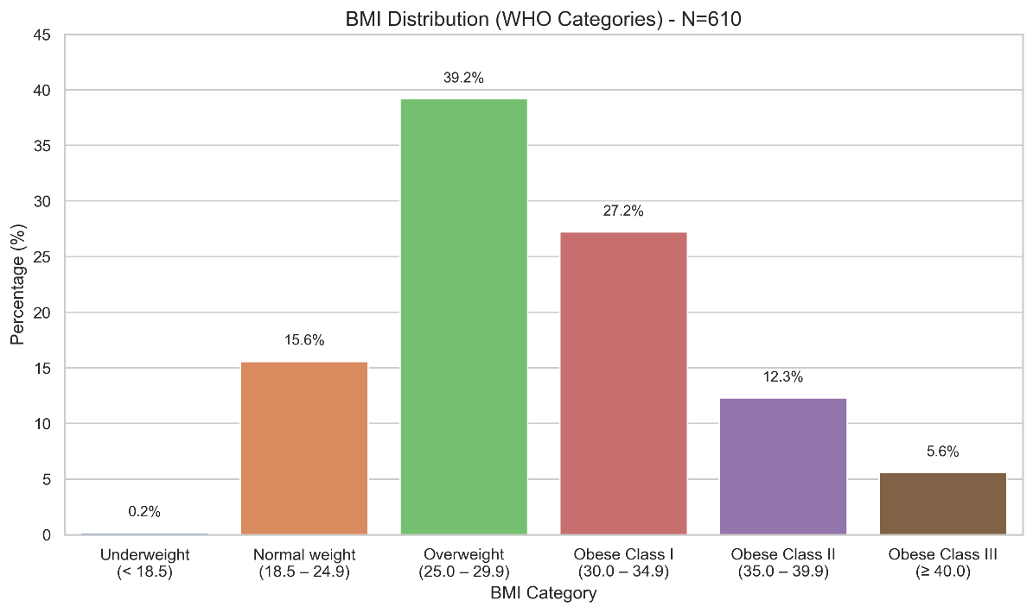
Health Characteristics
Low alcohol consumption: Nearly 90% of participants report zero daily alcohol intake
High prevalence of overweight and obesity: Over 84% of participants fall into overweight or obese BMI categories, indicating a strong need for metabolic and physical activity interventions.
Mixed Smoking History: While 46.1% have never smoked, a notable 33% are former smokers

Slide 15
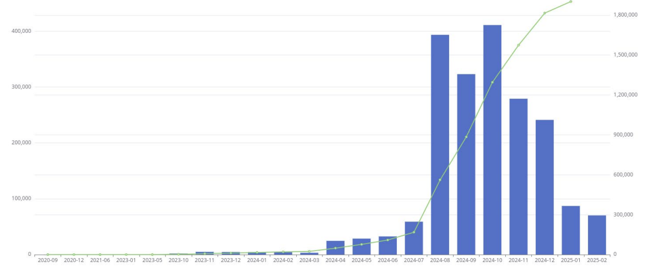

Slide 16
Usability Evaluation
Questionnaire | Evaluated Factors | #Items | Greek Score | CrossPilot | Good Score
IBM Satisfaction | Satisfaction | 22 | 6.15 | 5.35 | 5+
Usability Metric for User Experience | Effectiveness, Satisfaction, Overall, Efficiency | 4 | 63.96% | 73.83% | 70+
Mobile Health App Usability Questionnaire | Ease of use, satisfaction, system information arrangement, usefulness | 18 | 5.90 | 5.36 | 5+
Net Promoter Score | Satisfaction | 1 | 85% | 64% | 50+
Unified Theory of Acceptance and use of technology | Technology Acceptance evaluation | 32 | 5.64-6.46 | 5.15-5.81 | 5+
Would you recommend SMARTBEAR to someone else? |  |  |  | 95% Yes

Slide 17
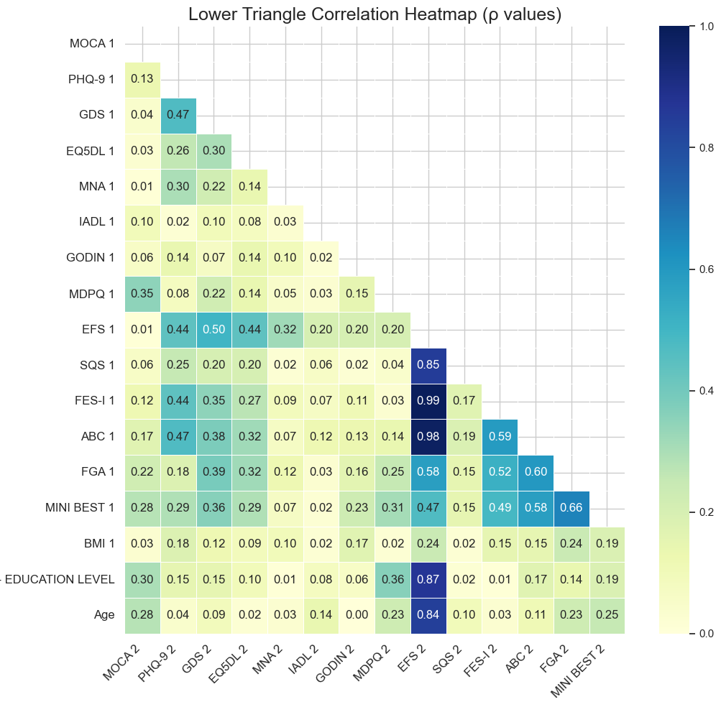
Variable Correlations
Input data: Baseline (1), Follow-up (2)
Absolute Pearson correlation coefficients between baseline (1) and follow-up (2) from clinical questionnaires and demographics.
Values of 0.2-0.4 weak, 0.4+ moderate correlation
Evaluates linear relationship between variables
Cognitive and Physical
Emotional and Physical
Balance
🟧 Mental and Physical Well-being Connection: Moderate correlations between GDS, EQ5DL, and MNA suggest that better mood and nutritional status are linked with higher self-perceived HRQoL
🟨 Functional & Postural Interdependence: Strong correlations among EFS, FES-I, ABC, and MINI BEST highlight the close relationship between frailty, fall risk, and balance confidence
🟩 Balance Measures Aligned: The tight cluster between ABC, FGA, and MINI BEST shows these tools consistently capture similar aspects of dynamic postural control.

Slide 18
Multiple Linear Regression
Keep only independent variables adhering to:
  |r|>0.2
  P Value < 0.01
  N > 30
Evaluate multiple linear regression models with R²
Variable Combination | Predicted Score | R² | N
MDPQ 1, Age 1, MINI BEST 1 | MOCA 2 | 0.19 | 280
GDS 1, MNA 1, ABC 1 | PHQ-9 2 | 0.35 | 87
PHQ-9 1, MDPQ 1, FES-I 1, FGA 1 | GDS 2 | 0.41 | 86
PHQ-9 1, MDPQ 1, FES-I 1, FGA 1 | EQ5DL 2 | 0.25 | 84
FGA 1, Education 1, Age 1 | MDPQ 2 | 0.20 | 279
PHQ-9 1, EQ5DL 1 | SQS 2 | 0.23 | 90
GDS 1, EQ5DL 1, MNA 1, ABC 1, FGA 1, MINI BEST 1 | FES-I 2 | 0.40 | 125
EQ5DL 1, MDPQ 1, FES-I 1, FGA 1, MINI BEST 1 | ABC 2 | 0.50 | 268
EQ5DL 1, GODIN 1, FES-I 1, MINI BEST 1, BMI 1, Age | FGA 2 | 0.49 | 251
GDS 1, MDPQ 1, FGA 1, Age | MINI BEST 2 | 0.44 | 263
Strongest Predictive Model: The model predicting ABC 2 (balance confidence) achieved the highest explanatory power (R² = 0.50), using baseline EQ5DL, MDPQ, FES-I, FGA, and MINI BEST scores.
Balance Outcomes Are Well-Predicted: Both FGA 2 (R² = 0.49) and MINI BEST 2 (R² = 0.44) models showed strong predictive value, highlighting the reliability of multi-domain baseline scores in estimating future balance performance.
Mental Health Scores Predict Future Well-being: Baseline PHQ-9, GDS, and related functional scores significantly predicted their corresponding outcomes, with GDS 2 and PHQ-9 2 models reaching R² values of 0.41 and 0.35, respectively.

Slide 19


The Holobalance Solution
Approximately one in three of all older adults fall each year, with wide ranging physical, psychosocial and healthcare-related consequences. Exercise-based interventions are the cornerstone for falls prevention programmes, yet these are not consistently provided, do not routinely address all components of the balance system and are often not well attended.
The HOLOkit system provides an evidence-based balance training programme delivered to patients in their home environment using a novel technological approach including an augmented reality virtual physiotherapist, exergames and a remote monitoring system.

Slide 20
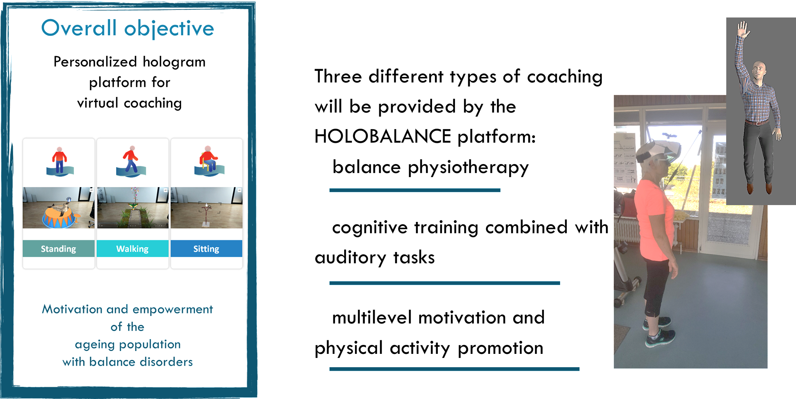
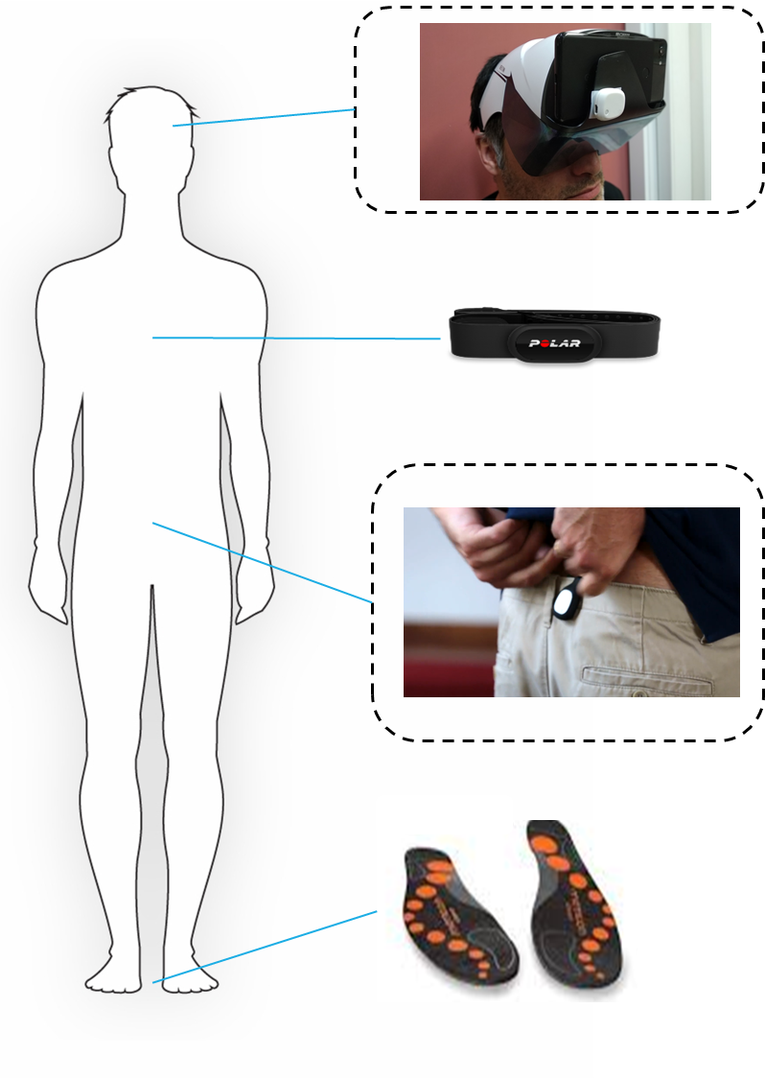
How does it work?

Slide 21
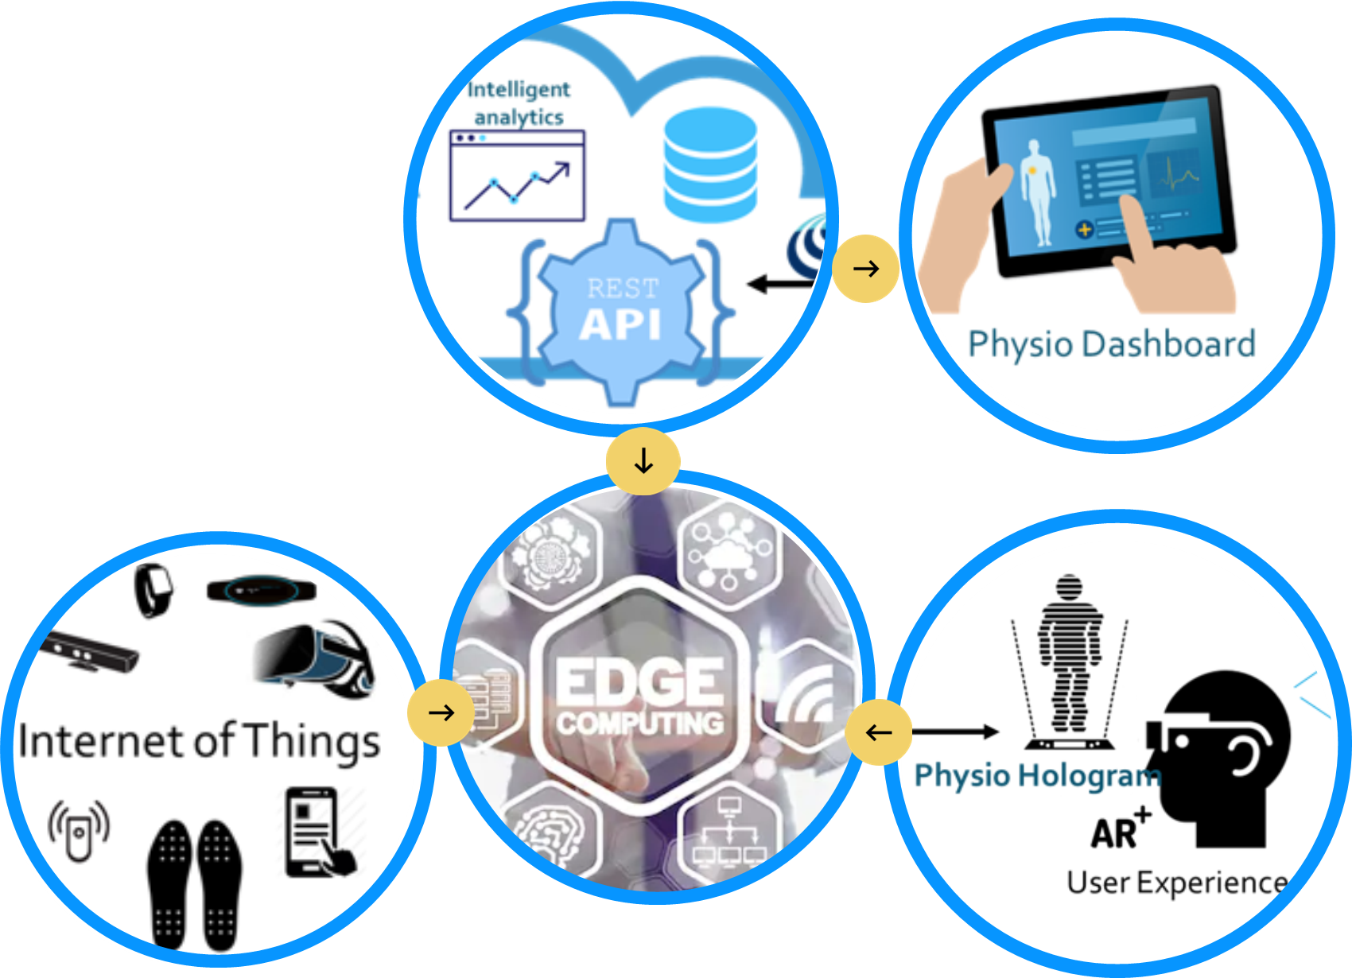

Holobalance in SMART BEAR
The SMART BEAR platform uses technologies to enable continuous data collection that enable delivery of evidence based, personalised interventions promoting healthy and independent living.
Both projects aim at promoting independent living in ageing population and target patients with balance disorders.
HOLOBALANCE could provide a personalised intervention based on a novel platform for virtual coaching, using holographic physiotherapists surrogates.

Slide 22



Population – Municipality of Palaio Faliro Intervention Group
Adults (65 – 80) years old
Able to walk 500m independently or with a stick
No significant visual impairment
N_{total} = 49 → 41 participants
Greek Pilot
Intervention group
MoCA score > 22 (no/mild cognitive impairment)
At risk of falls (FGA < 22/30), high feat of falling (FES-I > 10), or recent fall (last 12 months)
Exclude participants who did not provide complete answers in the questionnaires after internation (n = 8)
Willing to follow training/testing protocol
1x2m home space & adequate broadband
No orthostatic or uncontrolled hypertension
No Stroke, Parkinson’s, or peripheral neuropathy.
No acute musculoskeletal injury preventing exercise

Slide 23




Data Collection
Standardized Questionnaires
FES-I
Range: 10-100
Fear of falling
Lower scores indicate less fear and greater confidence
ABC
Range: 0-100
Balance Confidence
Higher values reflected increased confidence
HOLOBOX
Sitting (3 variations)
Standing (4 variations)
Walking (4 variations)
FGA
Range: 0-30
Gait & Balance Ability
Higher scores reflect higher functionality
MINIB
Range: 0-28
Postural Control
Higher scores reflect less balance impairments
Depth Camera
Head IMU
RAPA
Range: 1-9
Aerobic, strength, & flexibility activity
Higher scores reflect higher overall physical activity
Trunk IMU
Right Pressure + IMU
Left Pressure + IMU

Slide 24




Analytics Objectives
Gait-Related Questionnaires
Poor Outcomes
Effect Size
Features
Evaluate the statistical significance of the rehabilitation intervention using gait-related questionnaires (FGA, FES, ABC, MINIB)
Quantify the effect size of the intervention to determine its clinical impact
Preprocess, engineer, and select features from the dataset to ensure high-quality input for model training
Identify participants at risk of poor outcomes early by predictive analytics to enable timely intervention
01
02
03
04
Smart Bear - Project Overview

Slide 25




Questionnaire Analysis
Shapiro-Wilk Test
Non-Parametric Alternative
A Shapiro–Wilk test is applied to assess whether the distribution of paired differences (after-before the intervention) is normal.
If normality is not confirmed, a non-parametric alternative is used. A Wilcoxon signed-rank test is performed along with computation of rank-biserial correlation as an effect size estimate.
01
02
03
04
Parametric Approach
Effect Sizes
If the previous test confirms normality, a parametric approach is followed. A paired t-test is conducted with Bonferroni correction for multiple comparisons
Cohen’s d for parametric tests and Rank-Biserial Correlation for non-parametric tests—quantify the magnitude of the intervention's impact beyond mere statistical significance.
Smart Bear - Project Overview

Slide 26
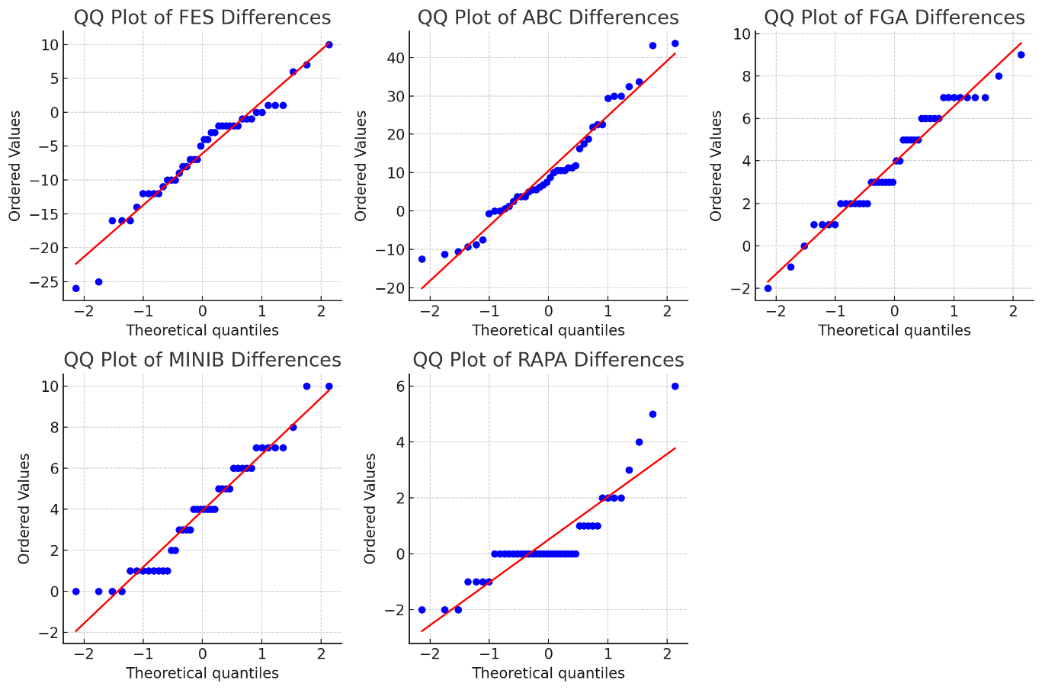



Questionnaire Analysis
Score | Shapiro-Wilk P-Value | Normality
FES-Ι | 0.1815
ABC | 0.0834
FGA | 0.1744
MINIB | 0.0388
RAPA | 0.0000
Smart Bear - Project Overview

Slide 27
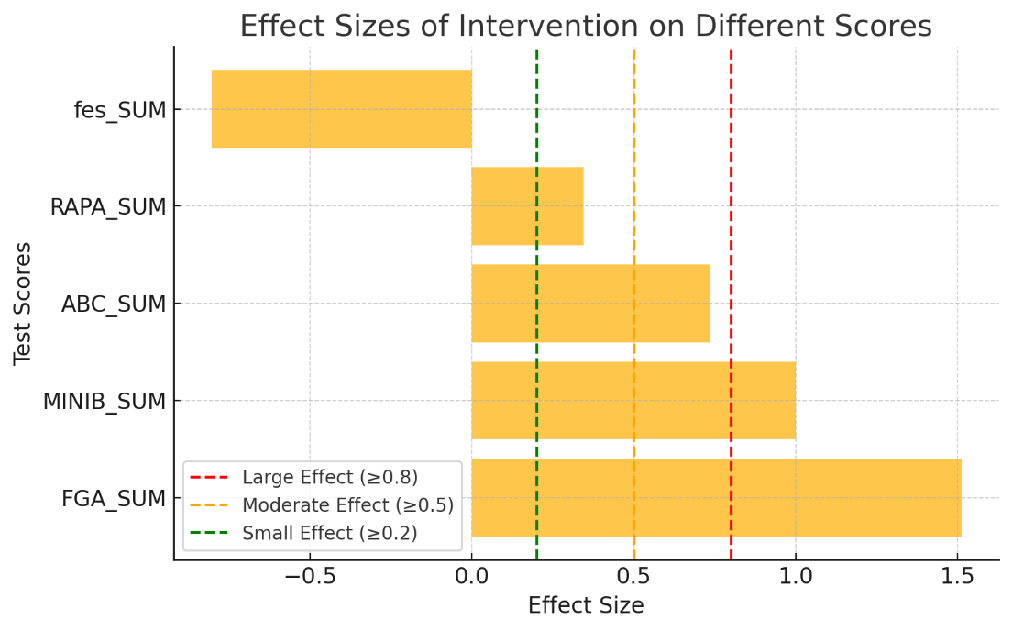
Questionnaire Analysis
Score | T-Statistic | P-Value | Significance
FES-Ι | -5.2202 | 5.507e-06 | Significant
ABC | 4.7874 | 2.362e-05 | Significant
FGA | 9.7989 | 2.654e-12 | Highly Significant
Score | Wilcoxon Statistic | P-Value | Significance
MINIB | 0.0 | 7.147e-08 | Significant
RAPA | 59.0 | 0.081 | Not Significant
Smart Bear - Project Overview

Slide 28
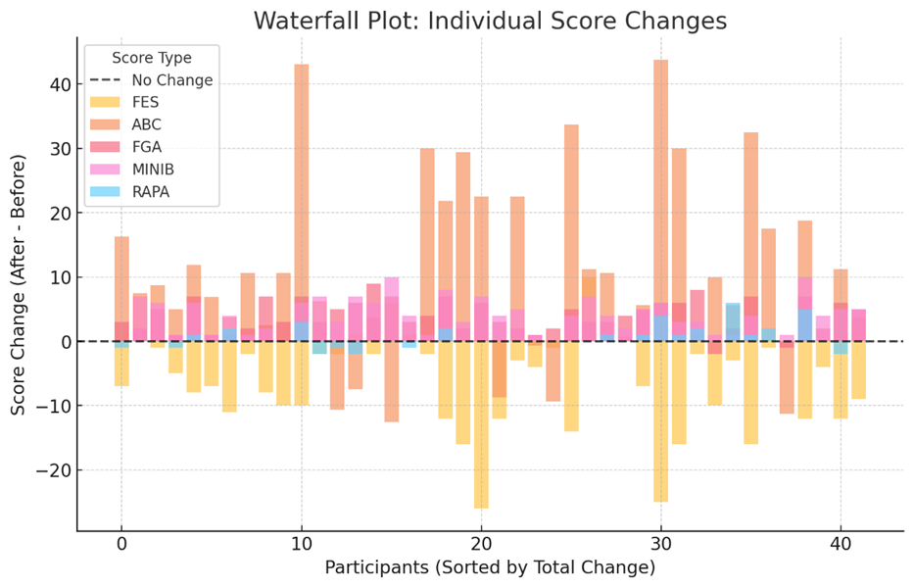
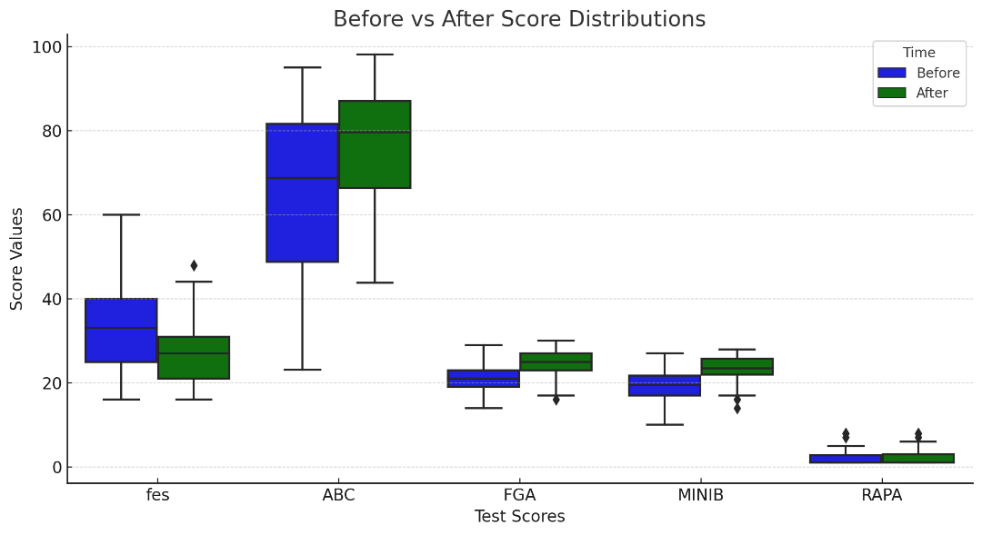
Holobalance Impact
Smart Bear - Project Overview

Slide 29

Model Development - Input & Output
Prediction: ΔS
Input data
Pre-Intervention Questionnaire
Post-Intervention Questionnaire
………..
Timepoint 1
Timepoint 2
Timepoint n
In between timepoints
Timepoint Final
ΔS = Post – Pre Questionnaire Scores
Timepoint ←→ Session
Past horizon ≥ 3 sessions
Past horizons of 3,4,5,6,7 sessions are examined to optimize performance and early prediction trade-off
Smart Bear - Project Overview

Slide 30



Feature Ranking & Selection, Model Development
FGA
Regression Approach: This difference served as the regression target for further analysis and was calculated using the formula:
${ΔS}_{i}=S_{after,i}−S_{before,i}$,
where: ${ΔS}_{i}$: represents the change in toral score for the participant $i$, $S_{after,i}$: denotes the total score after the intervention,$S_{before,i}$: denotes the total score before the intervention.
Target | Feature Selection | ML Models | MAE | MSE | R²
ABC | RFE | AdaBoost | 3.007809 | 13.35478 | 0.843995
FGA | RelieF | XGBoost | 0.717975 | 1.077799 | 0.783409
FES-I | RFE | AdaBoost | 2.574882 | 11.07303 | 0.709028
MINIBest | RelieF | XGBoost | 1.237087 | 2.809568 | 0.599128
Smart Bear - Project Overview

Slide 31

HOLOBALANCE Intervention - Key Takeaways
Smart Bear - Project Overview

Slide 32


Cost Effective Care adoptable by NHS and people
MAFEIP: Monitoring and Assessment Framework for the European Innovation Partnership on Active and Healthy Ageing
  An official tool provided by EC (https://www.mafeip.eu/)
Simulates and estimates the health and economic outcomes of ICT enabled social and health innovations
  A Markov model-based simulation
Smart Bear - Project Overview

Slide 33
Cost Effective Care adoptable by NHS and people
  Clinical data
    Diseases’ progressive stages thresholds of the parameters monitored in pilots
    Initial distributions and transitions of patients among the disease stages
  Costs
    Intervention costs (one-off and recurrent costs)
    Healthcare costs (standard care costs)
  Utilities (Health-related Quality of Life - HRQoL)
Smart Bear - Project Overview

Slide 34

Cost Effective Care adoptable by NHS and people
  Clinical data
    Diseases’ progressive stages thresholds of the parameters monitored in pilots
    Initial distributions and transitions of patients among the disease stages
    Mortality Rates for the Diseases and the population in question (Mortality Database, WHO)
  Costs
    Intervention costs (one-off and recurrent costs)
    Healthcare costs (standard care costs)
  Utilities (Health-related Quality of Life - HRQoL)
Smart Bear - Project Overview

Slide 35

MAFEIP SIMULATIONS: PROGRESSIVE STAGES OF DISEASES
Identification of health parameters and corresponding thresholds of progressive stages
  MCI -> MOCA score
  Mild Depression -> PHQ9
  Balance Disorders -> FES-I
  CVD -> BMI
  Frailty -> EFS score
  Hearing Loss –> HA benefit according to GHABP
Total patient counts, initial distribution and transitions probabilities among stages
MILD COGNITIVE IMPAIRMENT (MCI)
Parameter: MOCA Score
Parameter Ranges | Description | Notes | Mapping of parameter ranges to stages of disease
> 26/30 | Cognitively normal | Healthy | Baseline
18-26/30 | MCI | Pre-dementia | Stage 1
11-17/30 | Mild Dementia | Dementia stages | Stage 2
6-10/30 | Moderate Dementia
<6/30 or not testable | Severe Dementia |  | Stage 3
 |  |  | Death
Smart Bear - Project Overview

Slide 36

MAFEIP SIMULATIONS OUTPUTS
A set of interactive graphs and diagrams, grouped in four different categories:
  Incremental costs and effects
    Incremental cost and incremental effects based on health-related quality of life (Quality-Adjusted Life Years QALYs)
  Cost-effectiveness
    Compare costs and healthcare to assess the adoptability of the intervention by the NHS
  Population impact
    Incremental costs and incremental effects (QALYs) accumulated over the model time horizon of the simulations
  Patients flow through model states
    Summarizes the transitions of the patients among the stages of the diseases
Smart Bear - Project Overview

Slide 37

INCREMENTAL COSTS AND EFFECTS
Incremental costs by age
  Incremental costs of our simulations uses fixed healthcare
    Healthcare costs not monitored (obtained from literature)
    Simulations show a worst case compared to the real situations
      Healthcare costs decrease thanks to a better health status of patients after the Smart Bear interventions
Incremental effects by age
  Smart Bear interventions provides additional QALYs with respect to standard care
Smart Bear - Project Overview

Slide 38



INCREMENTAL COSTS AND EFFECTS
Smart Bear - Project Overview

Slide 39

WILLINGNESS TO PAY
    To investigate the willingness of the end users (elderly people ) to pay for the SmartBear service, hence placing in the market, a WTP study was implemented.
    100 participants answered a WTP questionnaire
    The Van Westendorp methodology was applied to detect:
      the point of marginal cheapness
      the point of marginal expensiveness
      the point of optimal price
      the indifference price point
Smart Bear - Project Overview

Slide 40

FACTORS THAT AFFECT THE WILLINGNESS TO PAY
Smart Bear - Project Overview

Slide 41




Synopsis & Key Takeaways
1. Proven Clinical Effectiveness
1
2
3
4
3. Supports Healthy Ageing & Fall Prevention Policy
Demonstrated significant improvements in balance, gait, and fall risk reduction—core priorities in elder care.
Positive impact on cognition and mental health (e.g., improved MOCA, reduced PHQ-9 and GDS scores).
Predictive models enable personalized intervention pathways, aligning with precision health goals.
Aligns with national and EU priorities (e.g., “Healthy Ageing 2030”) and WHO fall-prevention frameworks.Offers an evidence-based, scalable solution to reduce fall-related hospitalizations and long-term care admissions.
4. Digital Health & Home-Based Care Enablement
2. Addresses Multimorbidity in Ageing
Successfully tested digital physiotherapy using augmented reality, wearable sensors, and remote monitoring.
Fits into MoH digital transformation goals and can decentralize rehabilitation, reducing clinical load
Over 96% of participants had ≥2 comorbidities; more than half had 4 or more.
The intervention supports the healthcare agenda on integrated, multimorbidity-aware care for older adults.
«Κάλλιον δὲ τὰ τῶν ἐργατῶν νοσήματα προλαμβάνειν καὶ προθεραπεύειν κατὰ τὸ δυνατόν» - Ιπποκράτης

Slide 42
Anastasios Rentoumis
Dimitrios Boucharas

